Slide 1

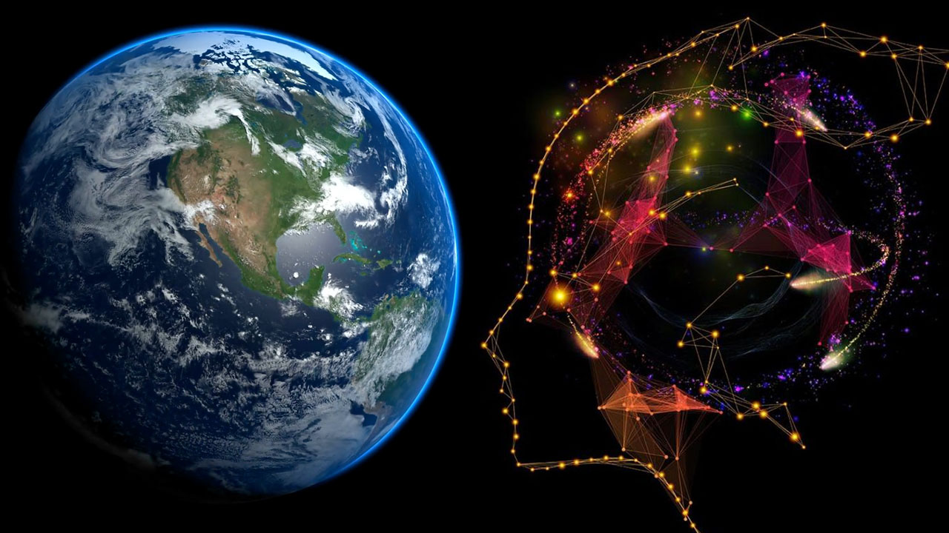
Spatial Machine Learning
Introduction to Spatial Data and Machine Learning
Dr. Giri Rajasekhar Gunnu
Professor of Practice, Andhra University
📧 g.giri.iitm@gmail.com
🔗 LinkedIn: girigunnu

Slide 2
Introduction and Objectives
1
From Data to Insight Through Maps

Slide 3
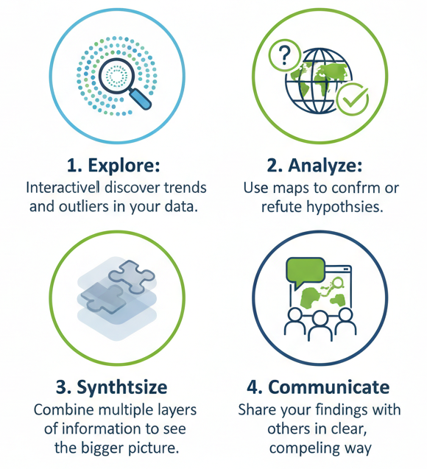
Why is Visualization So Important?
Human Brain: We are visual creatures. We can detect patterns in maps and images far more easily than in tables of numbers.

Slide 4
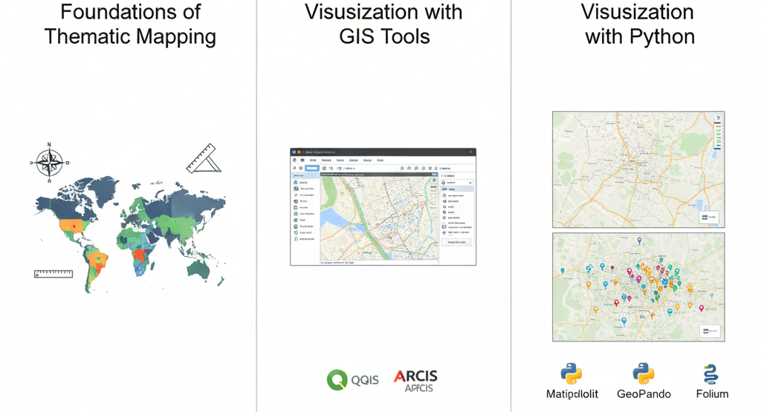
Topic Overview: What We Will Cover
Foundations of Thematic Mapping: The principles of cartography and different types of spatial maps.
Visualization with GIS Tools: Creating high-quality static maps using software like QGIS or ArcGIS.
Visualization with Python: Building both static and interactive maps using powerful libraries like Matplotlib, GeoPandas, and Folium.

Slide 5
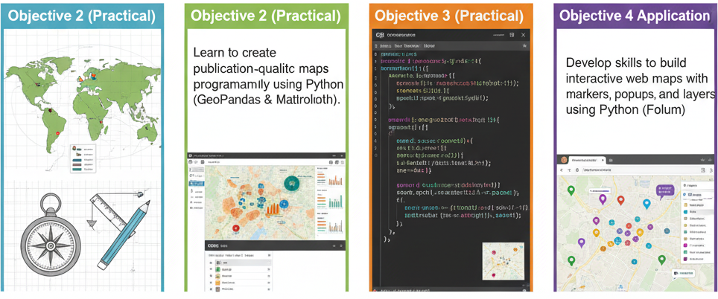
Learning Goals & Objectives
Objective 1 (Theory): Understand the key principles of cartography and learn to choose the right map type for your data and message.
Objective 2 (Practical): Gain proficiency in creating and styling thematic maps (e.g., choropleth, proportional symbol) in a standard GIS environment.
Objective 3 (Practical): Learn to create publication-quality static maps programmatically using Python (GeoPandas & Matplotlib).
Objective 4 (Application): Develop skills to build interactive web maps with markers, popups, and layers using Python (Folium).

Slide 6
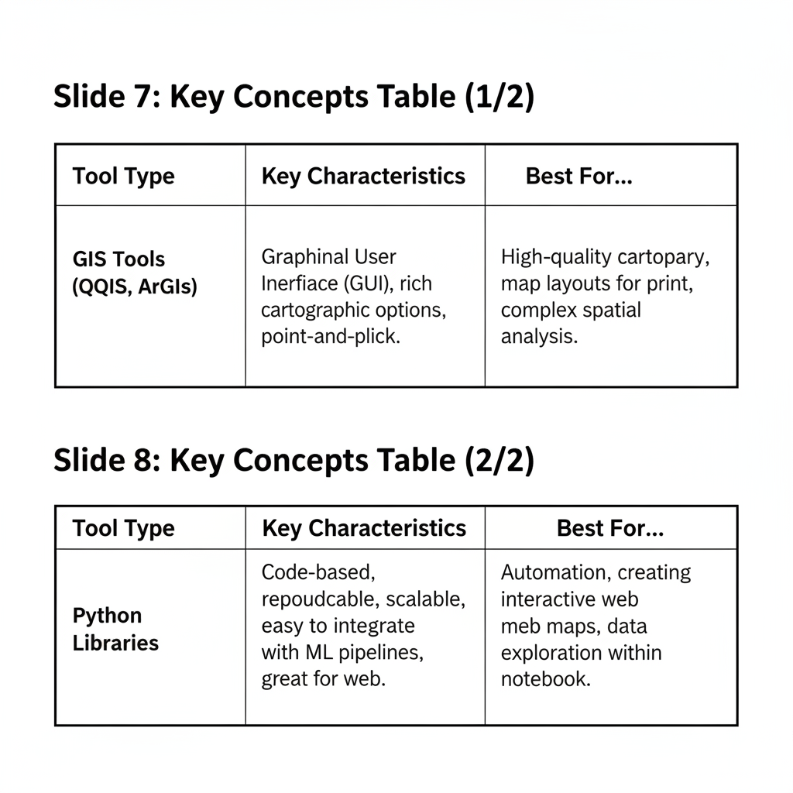
Key Concepts

Slide 7
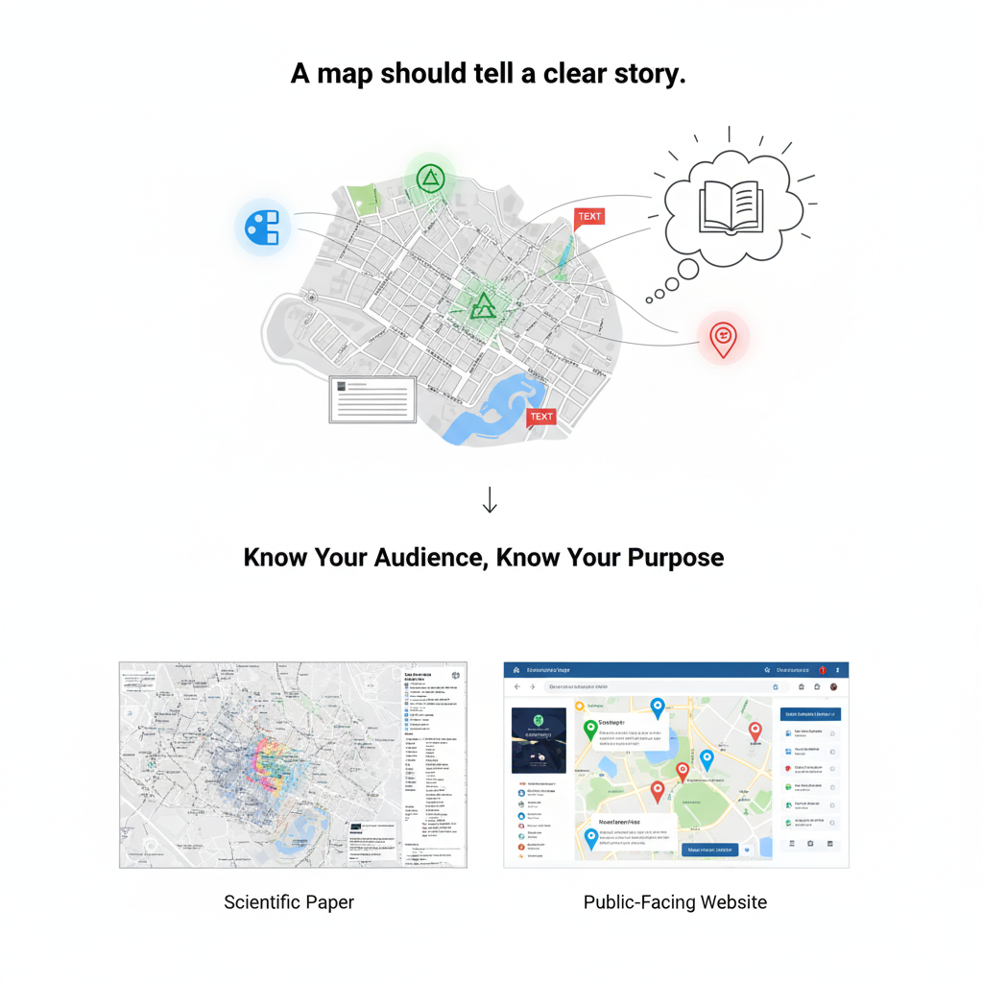
The Golden Rule of Cartography

Slide 8
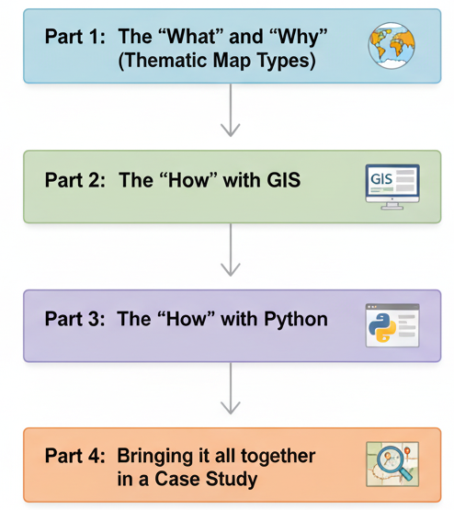
Map of the Presentation

Slide 9
Visualising with GIS Tools & Thematic Maps

Slide 10
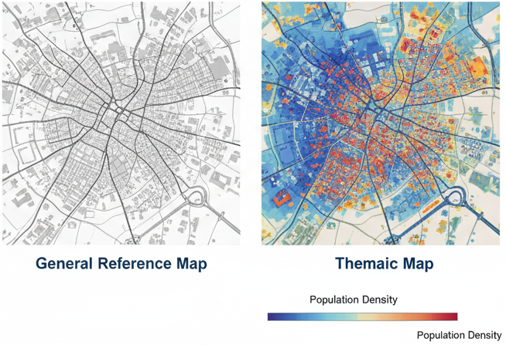
Thematic Maps: Telling a Story with Data
Definition: A thematic map is a map that focuses on a specific theme or subject area. It's different from a general reference map, which just shows locations.
Our Goal: To visualize the spatial pattern of a single variable.

Slide 11
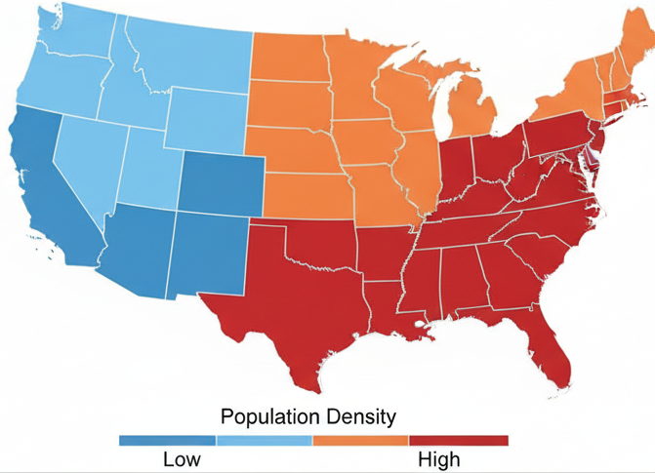
Map Type 1: The Choropleth Map
Concept: A map where predefined areas (like countries, states, or census tracts) are shaded or patterned in proportion to a measurement of a statistical variable.
Example: A map of the USA with each state colored by its population density.

Slide 12
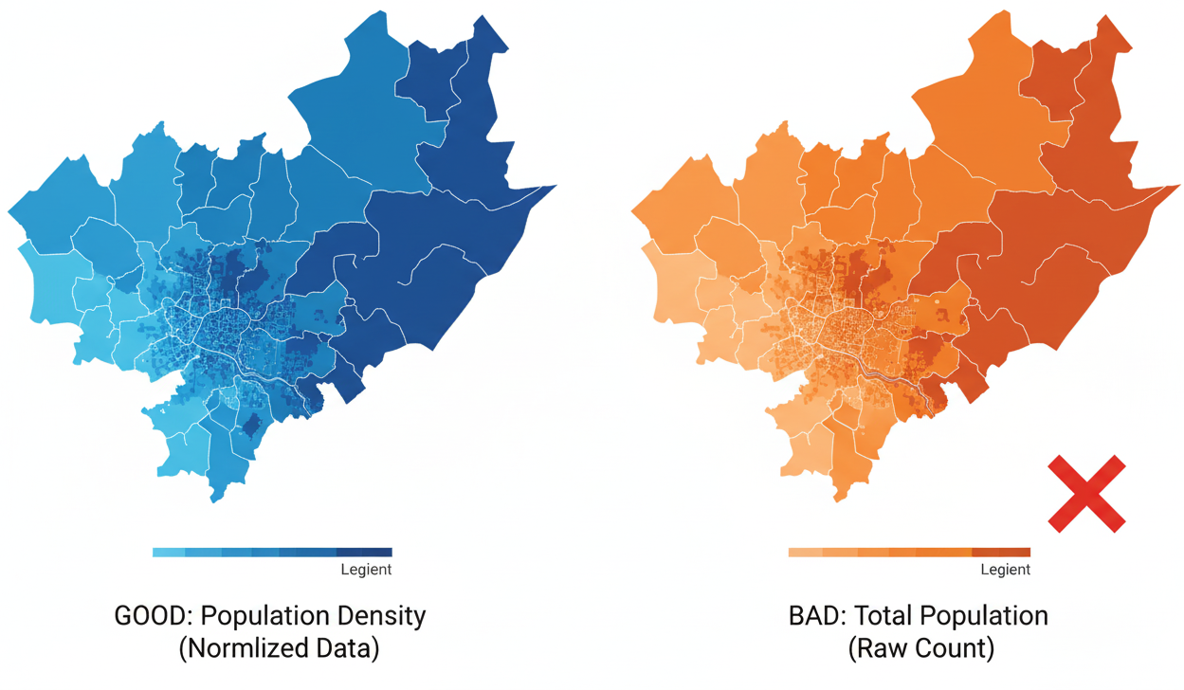
Choropleth Maps: Best Practices
CRITICAL: Always use normalized data (e.g., rates, densities, percentages), NOT raw counts. A state with a high count of hospitals might just be a very large state. You want to map hospitals per capita.
Color Choice: Use sequential color schemes (light to dark) for continuous data.

Slide 13
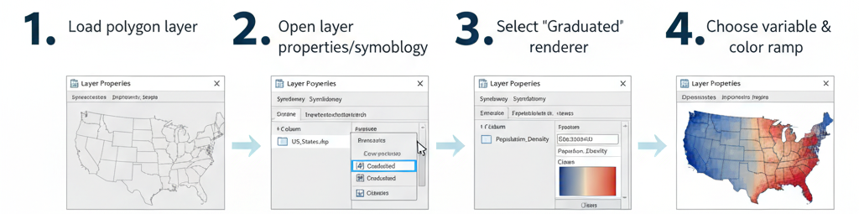
GIS Workflow: Creating a Choropleth Map

Slide 14
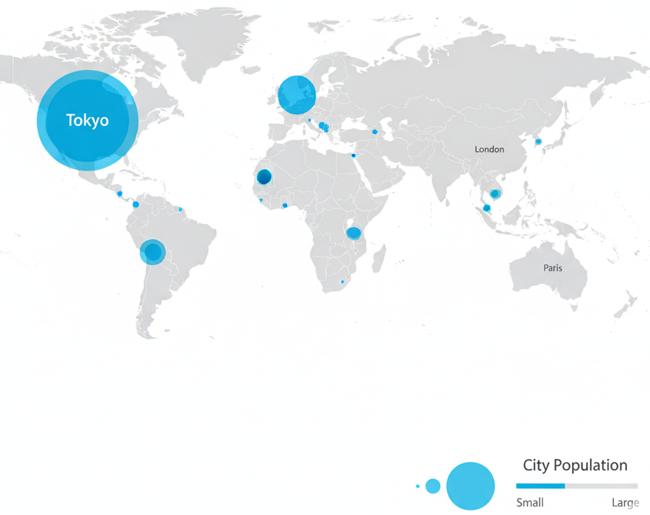
Map Type 2: Proportional Symbol Map
Concept: The size of a symbol (usually a circle) placed on a point or the center of a polygon is scaled in proportion to the value of the variable.
When to Use: Excellent for showing raw counts when the size of the underlying area is not important.
Example: Mapping the population of major cities on a world map.

Slide 15
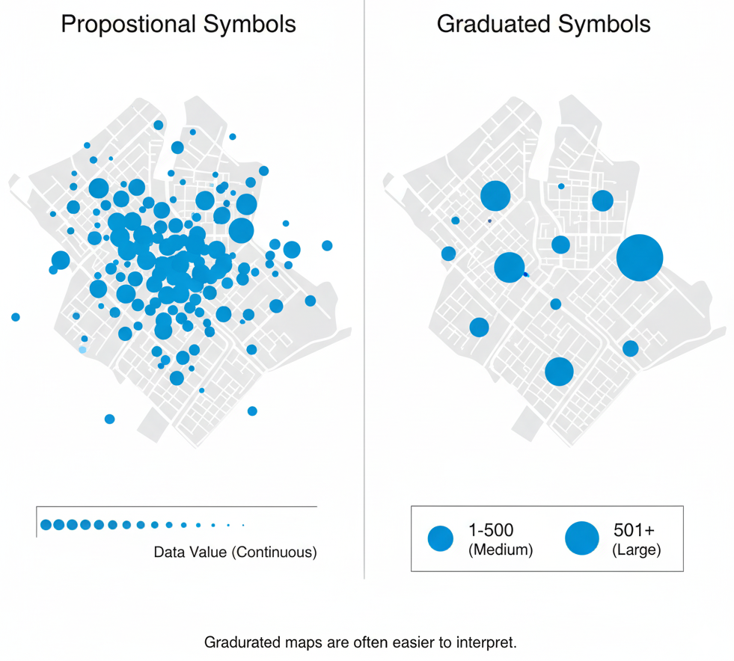
Proportional vs. Graduated Symbols
Proportional: Symbol size is directly and continuously scaled to the data value.
Graduated: Data is first classified into ranges (e.g., 1-100, 101-500), and all features in a range get the same size symbol. Graduated is often easier for map readers to interpret.

Slide 16
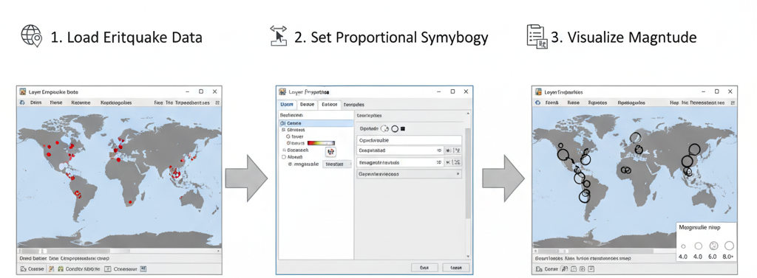
GIS Application: Mapping Earthquake Magnitudes

Slide 17
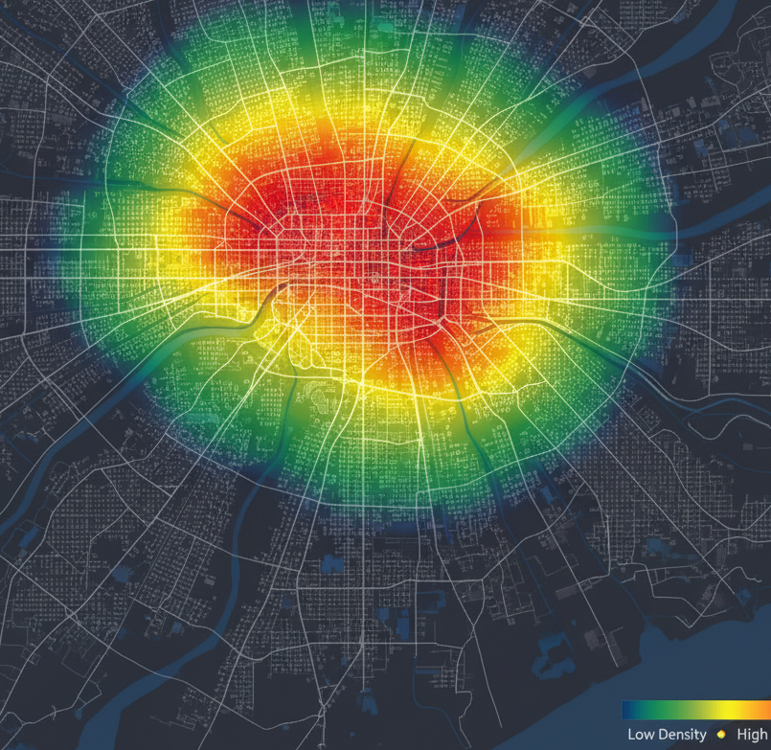
Map Type 3: Heatmap (Kernel Density)
Concept: Visualizes the geographic density of point data. It calculates the density of features in a neighborhood around each feature, creating a continuous surface of intensity.
When to Use: When individual points are too numerous to see a pattern, and you want to find "hotspots."
Example: Mapping the density of taxi pickups in New York City.

Slide 18
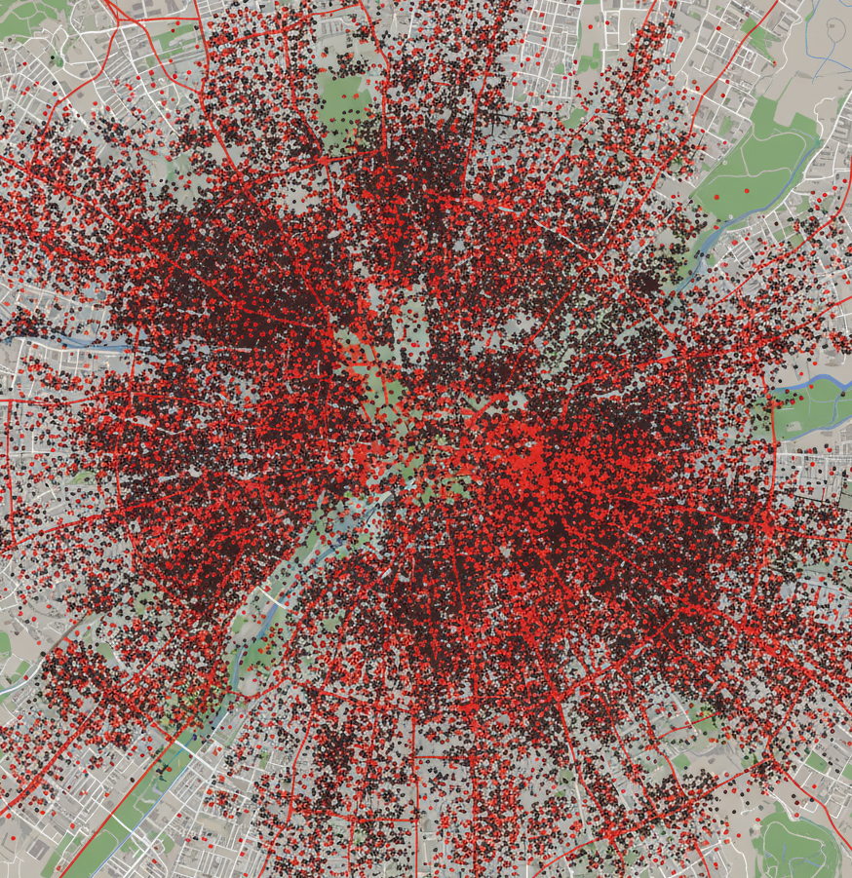
Case Study: Visualizing 311 Service Calls
Scenario: Visualizing thousands of 311 service call locations from a major city.
The Challenge: Overplotting
When we plot every single call as a point on the map, the points overlap so much that the map becomes a cluttered, unreadable mess. This is called "overplotting."
The Result: No Insight
It is impossible to identify any meaningful patterns or concentrations.
Key Question: Where are the true hotspots of service requests? This map can't answer that.

Slide 19
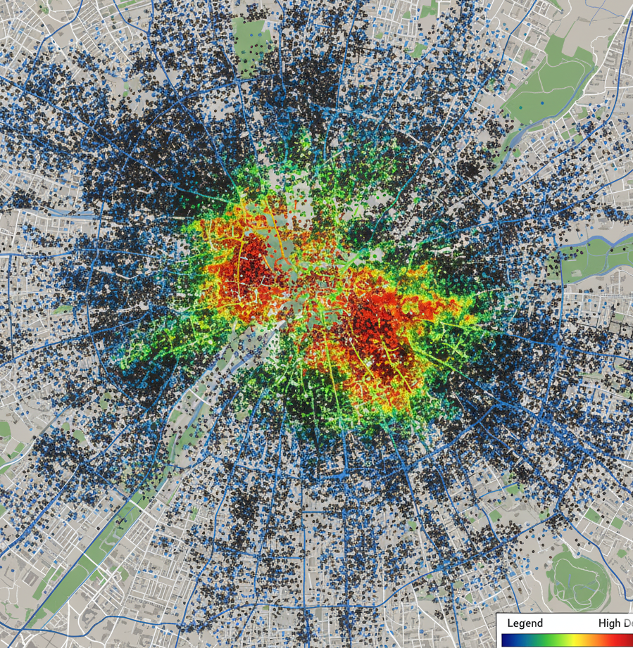
Case Study: Visualizing 311 Service Calls
The Technique: By applying a Kernel Density Estimation, we transform the thousands of individual points into a continuous surface of intensity—a heatmap.
The Result: Clear Insight
The visual clutter is gone. We can now instantly see the areas with the highest concentration of service calls.
The "hotspots" (fiery red/yellow areas) clearly stand out from the cooler (blue) areas.
Application: A city can use this insight to allocate resources more effectively, investigate why certain neighborhoods have high call volumes, and improve public services.

Slide 20
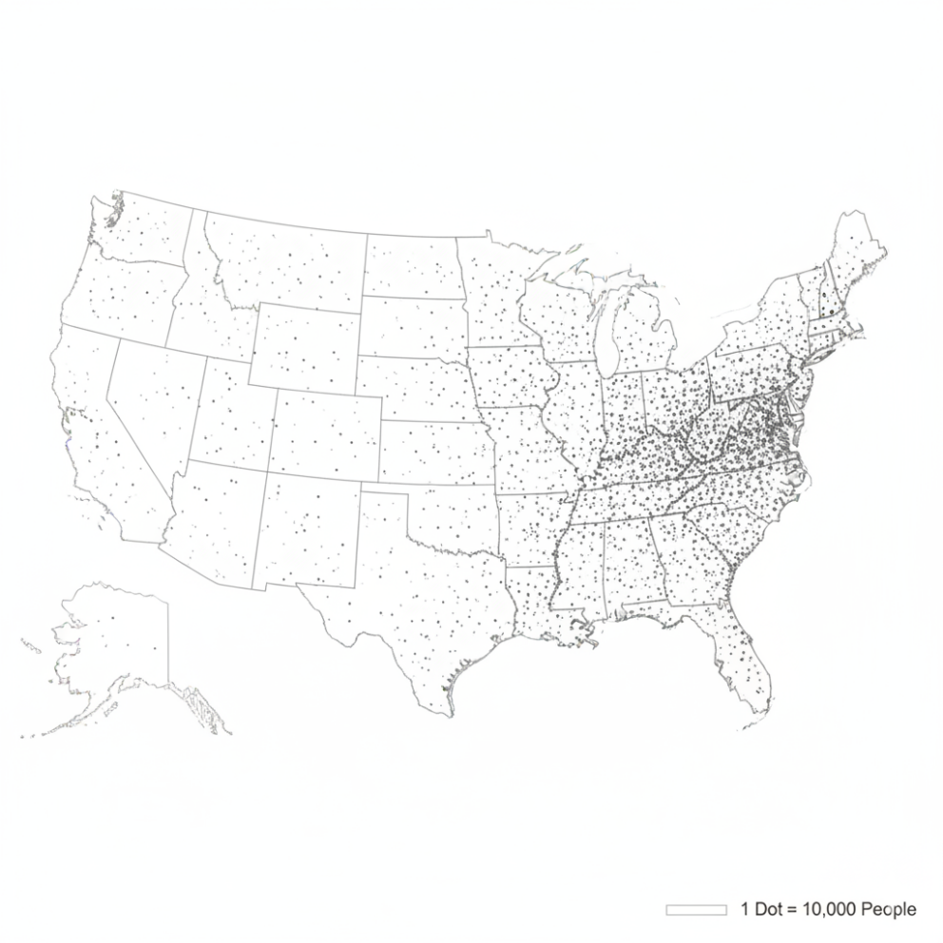
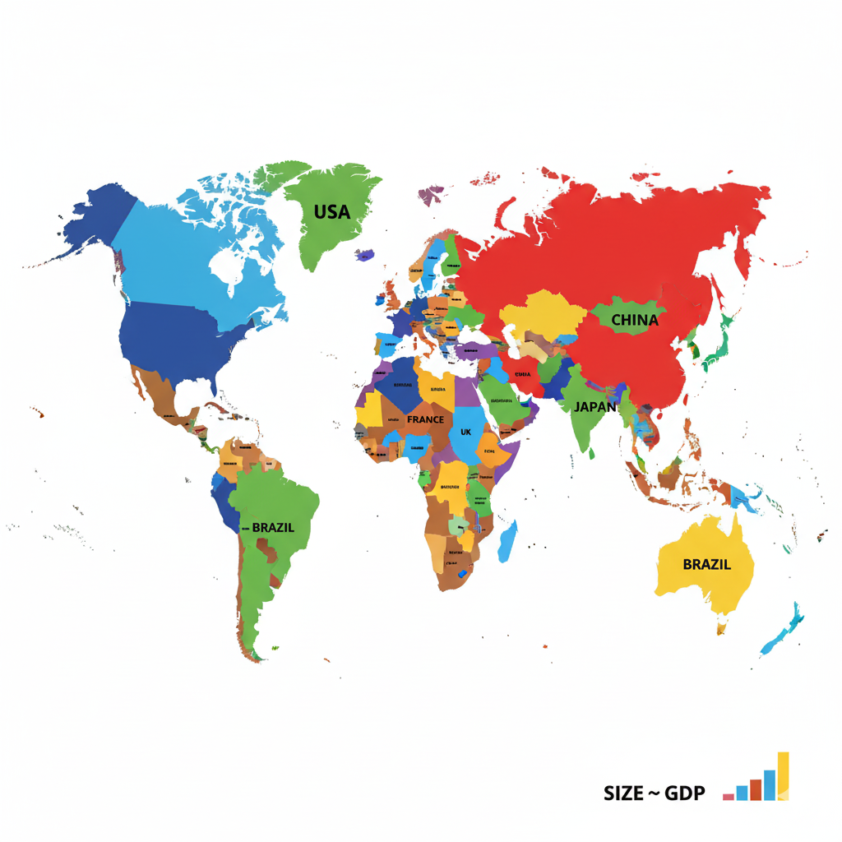
Other Common Map Types
Dot Density Map: Each dot represents a specific quantity of a variable (e.g., one dot = 1,000 people). Dots are placed randomly within the polygon.
Cartogram: The geometry of the map is distorted to convey the information of the variable (e.g., countries are resized based on their GDP).

Slide 21
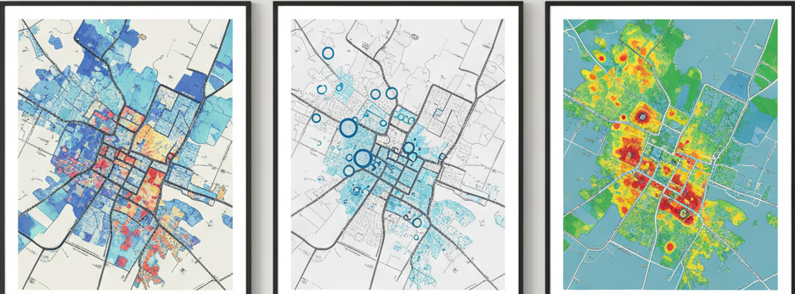
Summary of GIS Visualization
GIS tools provide a powerful, interactive, GUI-based environment for creating high-quality maps.
Choosing the right map type (choropleth, proportional symbol, heatmap) is critical for accurately telling your data's story.
Always remember the fundamentals: use normalized data for choropleths and choose sensible color schemes.

Slide 22
Visualising with Python Libraries

Slide 23
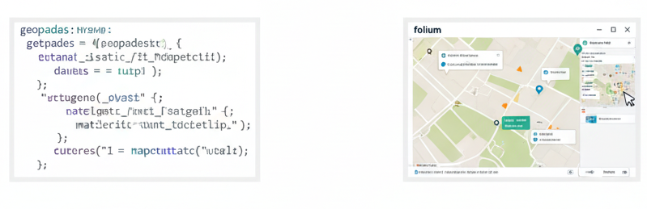
Why Python for Visualization?
Reproducibility: Your map is created by code, so it can be perfectly and automatically reproduced.
Integration: Your visualization code lives in the same environment as your data cleaning, feature engineering, and ML modeling code.
Scalability: Easily create hundreds of maps in a loop.
Interactivity: Create dynamic web maps that users can explore.

Slide 24
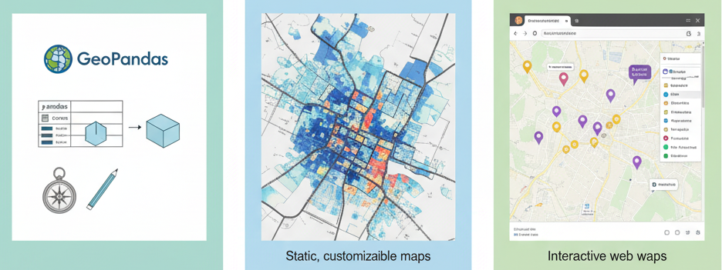
The Python Geospatial Stack
GeoPandas: The core library for working with vector data. It extends pandas DataFrames to have a geometry column.
Matplotlib: The foundational plotting library. GeoPandas uses it for its default .plot() method. Great for high-quality, static, customizable maps.
Folium: A library for creating interactive Leaflet.js maps. Excellent for web dashboards and data exploration.

Slide 25
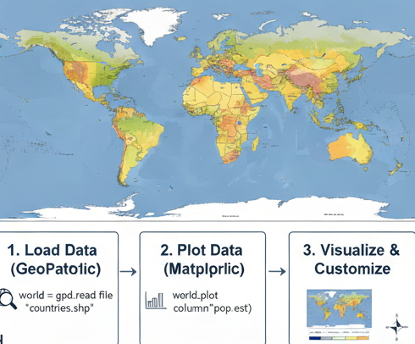
Static Maps: GeoPandas + Matplotlib
Concept: We use GeoPandas to load and manage the data, and its .plot() method (powered by Matplotlib) to create the map image.
This is the go-to combination for creating maps for reports, papers, and presentations.

Slide 26
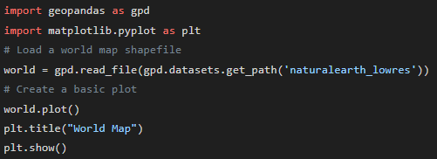
Python Code: Loading and a Basic Plot

Slide 27
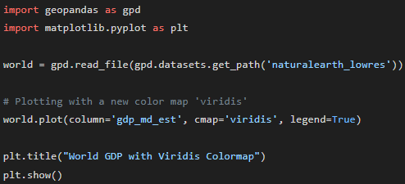
Creating a Choropleth Map with GeoPandas
Improving Clarity with a Better Color Map (cmap)
Concept: The default color map isn't always the best choice. Choosing the right color scheme is crucial for telling a clear story. For numerical data that goes from low to high, a sequential color map (e.g., from light blue to dark blue) is ideal.
Why it Matters: A good cmap (color map) makes patterns easier to see and is more accessible for people with color vision deficiencies. 'Viridis', 'Plasma', and 'Blues' are popular and effective choices.
The Code: We can easily change the color map using the cmap argument in the .plot() function.

Slide 28
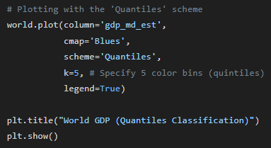
Adjusting the Classification Scheme
Changing the Story with Classification (scheme)
Concept: By default, GeoPandas uses a 'Natural Breaks' method to decide the ranges for each color. But we can control this! The scheme argument lets us choose how the data is binned.
Common Schemes:
Quantiles: Each color bin has the same number of features. Great for showing relative rankings.
EqualInterval: The entire range of data is split into equal-sized sub-ranges.
NaturalBreaks (Jenks): A statistical method that finds natural groupings in the data.
The Code: Let's switch to a Quantiles classification.

Slide 29
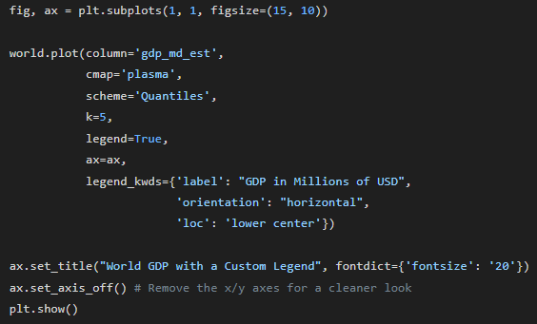
Customizing the Legend
Making a More Informative Legend (legend_kwds)
Concept: A good map needs a good legend. The default legend is useful, but often needs to be improved for clarity in a final report or presentation. We can pass a dictionary of keywords to the legend_kwds argument to customize it.
Customizations:
'label': Change the legend's title.
'orientation': Make the legend 'horizontal'.
'loc': Change the location (e.g., 'lower right').

Slide 30
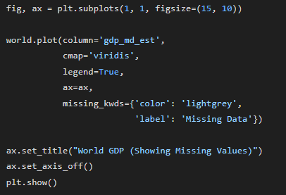
Handling Missing Values
Explicitly Showing Missing Data (missing_kwds)
Concept: What about countries that have no GDP data in our dataset? By default, they are just left blank, which can be confusing. It's much better to explicitly color them to show that data is missing.
How it Works: The missing_kwds argument allows us to define the appearance of features with missing values. We can specify a color, edge color, and a label for the legend.

Slide 31
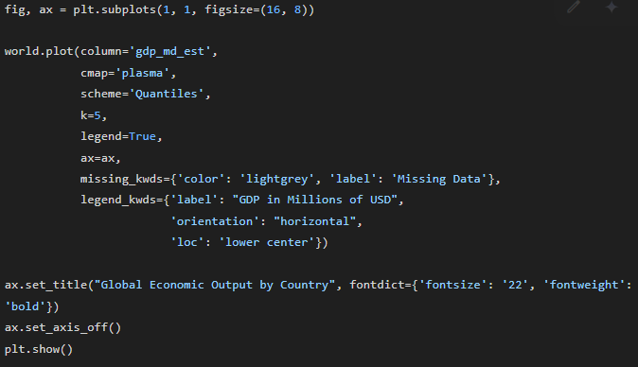
Putting It All Together: A Final Polished Map
Concept: By combining all the techniques—a good color map, a clear classification scheme, a customized legend, and explicit handling of missing data—we can create a professional, high-quality static map directly in Python.
Final Touches:
Adjusting the figure size (figsize) for better layout.
Removing axes (set_axis_off()) for a clean, modern look.
Adding a main title.

Slide 32
Case Study - Mapping US Unemployment Rates
Case Study Introduction: Visualizing Economic Patterns
Goal: To create a high-quality, static choropleth map that visualizes the spatial distribution of unemployment rates across the counties of the United States.
Question: Are there geographic patterns to unemployment? Are there "hotspots" or "coldspots" of high or low unemployment?
Dataset: We will use a GeoDataFrame of US counties, which contains polygon geometries and a column named unemployment_rate.
Methodology: We will use the GeoPandas library for data handling and its integration with Matplotlib for plotting a clear and informative map suitable for a report or analysis.

Slide 33
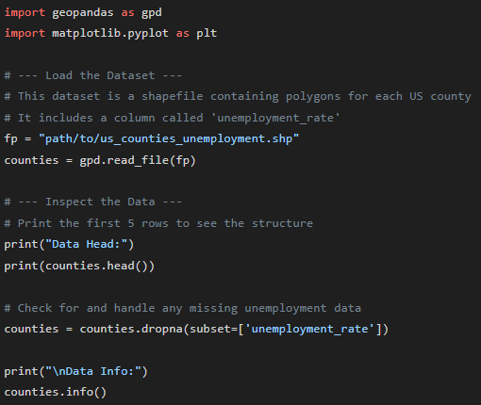
The Python Code - Step 1: Loading & Preparing the Data
Concept: The first step in any visualization task is to load our spatial data into a GeoDataFrame. We'll then inspect the data to ensure it's correct.
Explanation:
We import our necessary libraries: geopandas and matplotlib.pyplot.
We load the shapefile containing county geometries and their attributes into a GeoDataFrame called counties.
We print the .head() to check the column names and data types. This is a critical verification step.
We remove any rows where the unemployment rate is missing to avoid errors in plotting.

Slide 34
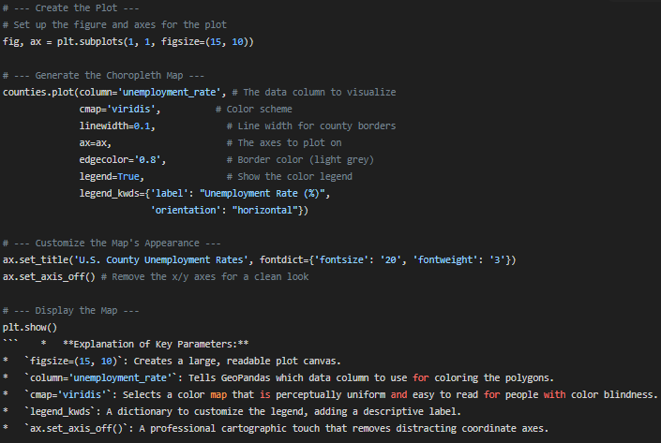
Python Code - Step 2: Creating and Customizing the Map
Concept: We now use the .plot() method on our GeoDataFrame. To create a high-quality map, we need to customize several parameters, such as the color scheme, legend, and title.

Slide 35
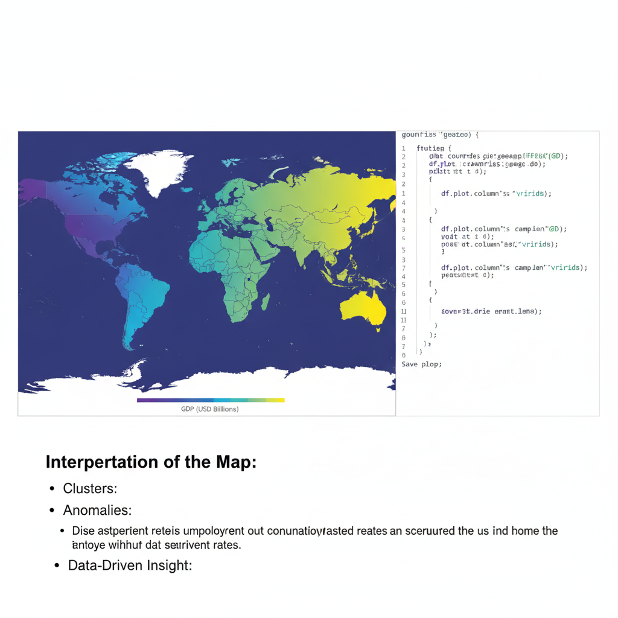
The Resulting Visualization: Analysis of the Map
Interpretation of the Map:
The choropleth map immediately reveals distinct spatial patterns that would be hidden in a spreadsheet.
Clusters: We can visually identify regional clusters. For example, areas in the Southeast and parts of the Southwest and West Coast might show higher unemployment rates (brighter colors in the 'viridis' scheme).
Anomalies: In contrast, large portions of the Great Plains and Midwest show consistently lower unemployment rates (darker colors).
Data-Driven Insight: The map provides a powerful, at-a-glance summary of regional economic health, prompting further questions about the underlying causes of these patterns.

Slide 36
Case Study Summary and Real-World Applications
Summary of What We Did:
Loaded a spatial dataset of US counties with a target variable (unemployment_rate).
Used GeoPandas and Matplotlib to programmatically generate a choropleth map.
Customized visual elements like the title, color scheme, and legend to create a clear, professional, and insightful visualization.
Application Context:
Government & Policy: Federal and state agencies use such maps to allocate resources, design economic aid programs (like enterprise zones), and monitor the effectiveness of policies over time.
Business Intelligence: A corporation might use this map to inform market expansion strategies, deciding where to open new factories or retail stores based on labor availability and local economic vitality.
Academic Research: Economists and geographers can use this map as a starting point to model the factors that influence unemployment, such as proximity to major cities, educational attainment, or dominant industries.

Slide 37
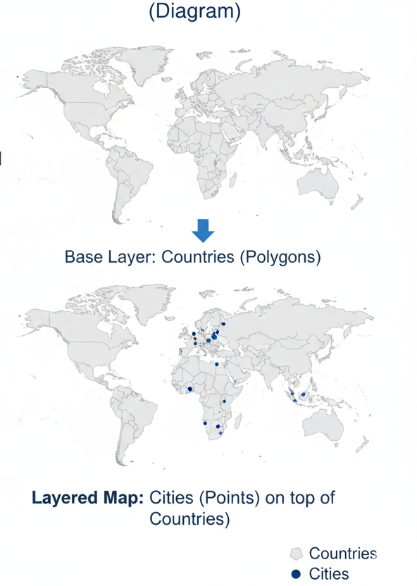
Layering Data with Matplotlib
Concept: You can plot multiple GeoDataFrames on the same Matplotlib axes to create layered maps.
Example: Plotting cities (points) on top of countries (polygons).

Slide 38
Python Code: Layering Example
Concept: Layering Maps to Tell a Richer Story
Title: The Power of Layering
Concept: A single data layer on a map is useful, but the real power of GIS and spatial visualization comes from layering multiple datasets on top of each other. This allows us to see and analyze the spatial relationships between different types of features.
Analogy: Think of it like creating a drawing on transparent sheets.
Base Layer: A map of country polygons.
Top Layer: A map of city points.
When you stack them, you see which cities fall within which countries.
The Technical Challenge: How do we tell our Python code to draw multiple plots on the exact same canvas?
The Solution: We use an Axes object from Matplotlib, conventionally named ax. We create one "canvas" (ax) and pass it to every plot command, ensuring all layers are drawn together.

Slide 39
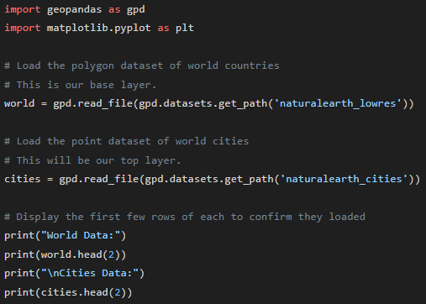
Python Code: Layering Example
Layering in Python: Step 1 - Setup and Data Loading
Title: Setting the Stage: Loading Our Layers
Objective: Before we can plot anything, we need to load our spatial datasets into GeoDataFrames. For this example, we will use two built-in datasets from GeoPandas: one for world countries (polygons) and one for major cities (points).

Slide 40
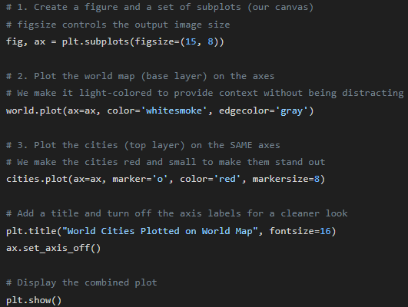
Python Code: Layering Example
Layering in Python: Step 2 - The ax Argument in Action
Title: Drawing on the Same Canvas
Process:
First, we create a figure and a single Matplotlib Axes (ax). This ax is our shared canvas.
Next, we plot our world GeoDataFrame, but we explicitly tell it which canvas to draw on by passing ax=ax.
Finally, we plot our cities GeoDataFrame, passing the exact same ax=ax argument. This forces the cities to be drawn on top of the world map.

Slide 41
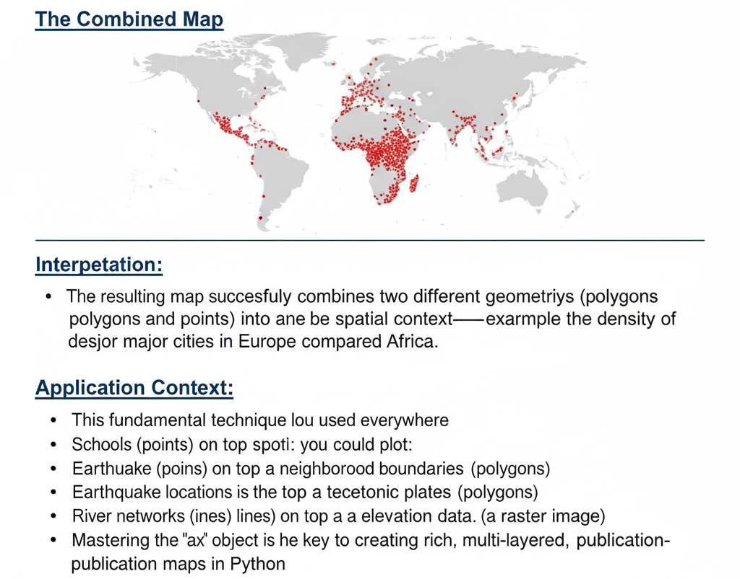
Layering in Python: The Final Result and Interpretation

Slide 42
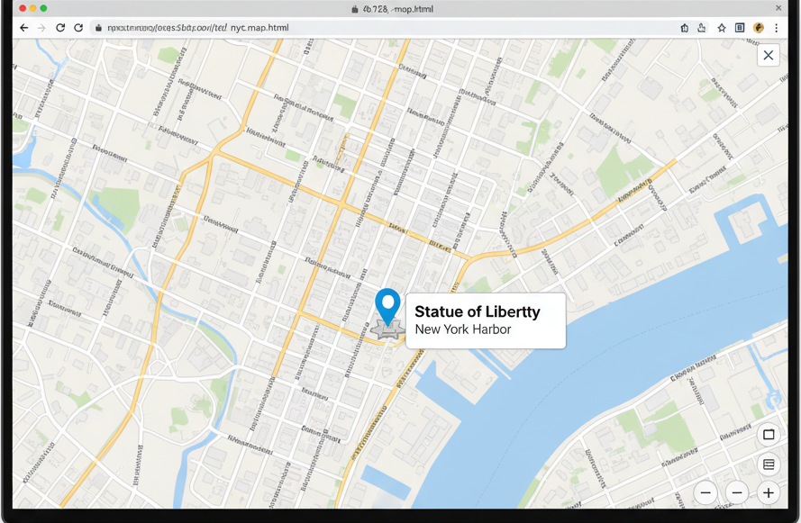
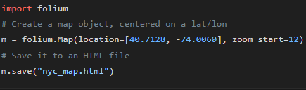
Interactive Maps: Folium
Concept: Folium allows you to create interactive maps that you can pan, zoom, and click on. It generates a self-contained HTML file.
Why it's great: Perfect for sharing your work with non-technical users or embedding in websites.

Slide 43
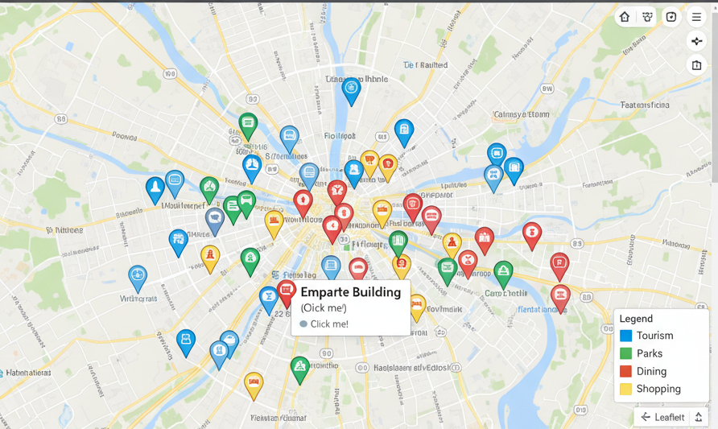
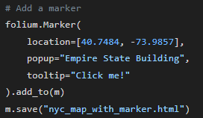
Adding Markers to a Folium Map

Slide 44
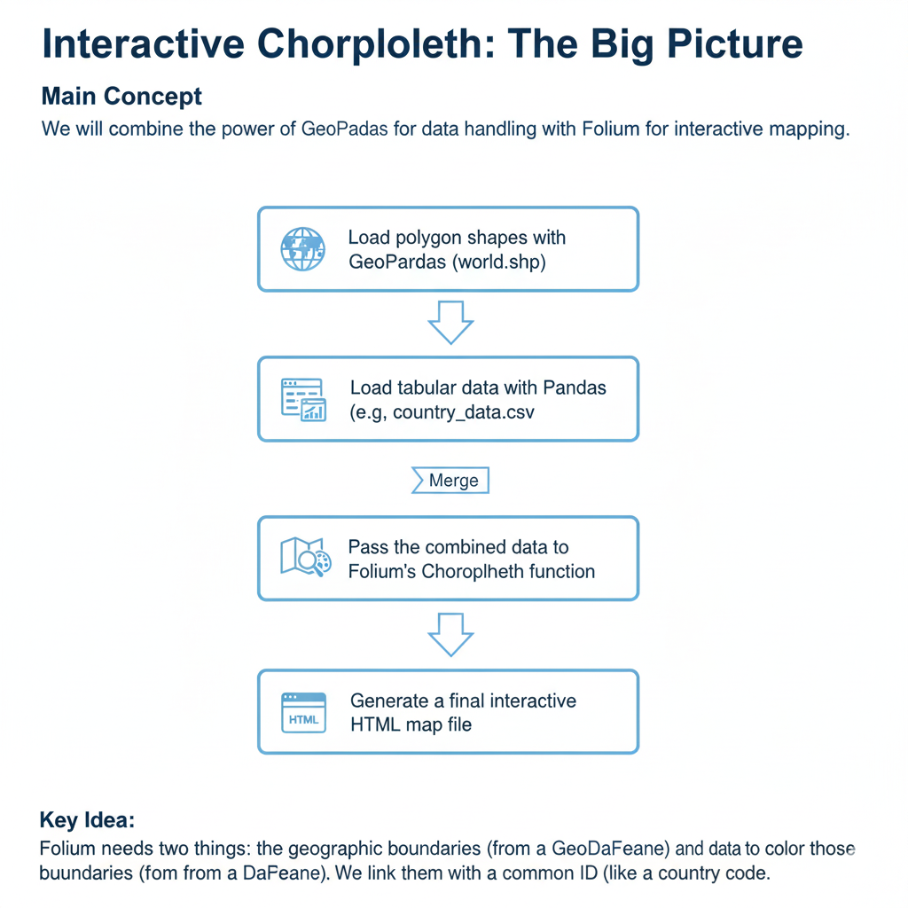
Creating an Interactive Choropleth with Folium

Slide 45
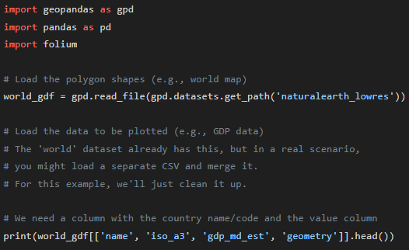
Creating an Interactive Choropleth with Folium
Step 1 - Preparing the Data
Objective: Load our libraries and prepare a GeoDataFrame that contains both the geometry and the data we want to visualize.
Explanation:
We import our three key libraries.
We load a GeoDataFrame called world_gdf.
Crucially, we confirm it has a geometry column for the shapes and a data column (gdp_md_est) to plot. It also has an ID column (iso_a3 or name) that we will use for linking.

Slide 46
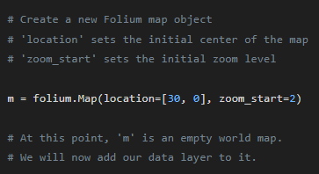
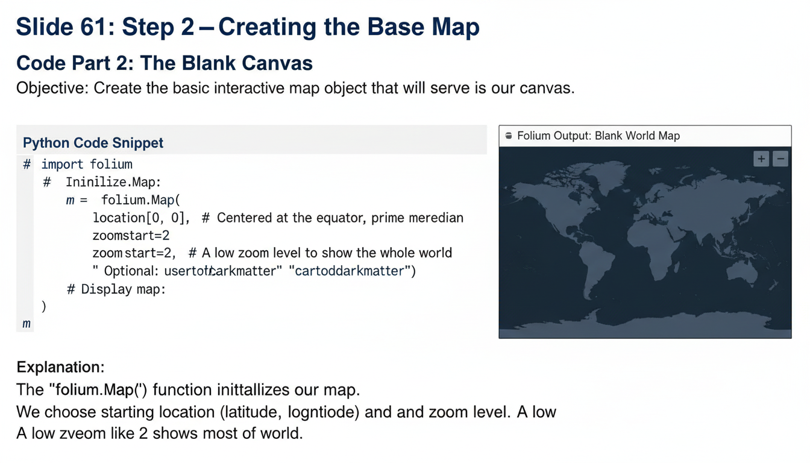
Creating an Interactive Choropleth with Folium
Step 2 - Creating the Base Map
Objective: Create the basic interactive map object that will serve as our canvas.
Explanation:
The folium.Map() function initializes our map.
We choose a starting location (latitude, longitude) and a zoom level. A low zoom level like 2 shows most of the world.

Slide 47
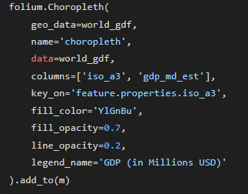
Creating an Interactive Choropleth with Folium
Step 3 - The Choropleth Command
Objective: Use the folium.Choropleth function to generate the data visualization layer. This is the most important step.
Explanation: This slide should have arrows pointing to each parameter of the code block.
geo_data: Points to our GeoDataFrame with the shapes.
data: Points to the DataFrame containing the values (in this case, the same one).
columns: The two columns to use: the ID key (iso_a3) and the value (gdp_md_est).
key_on: This is the magic link. It tells Folium to look inside the geo_data's properties for the iso_a3 field to match with our data.
fill_color, opacity, legend_name: These are all for styling the map.

Slide 48
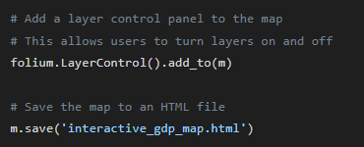
Creating an Interactive Choropleth with Folium
Step 4 - Adding Interactivity and Saving
Objective: Add a layer control and save the final map to an HTML file that can be opened in a browser.
Explanation:
LayerControl is essential if you have multiple layers (e.g., a choropleth and a set of markers). It creates the little checkbox panel in the corner of the map.
m.save() writes all the necessary HTML, CSS, and JavaScript into a single, portable file.

Slide 49
Creating an Interactive Choropleth with Folium
Step 4 - Adding Interactivity and Saving
Objective: Add a layer control and save the final map to an HTML file that can be opened in a browser.
Explanation:
LayerControl is essential if you have multiple layers (e.g., a choropleth and a set of markers). It creates the little checkbox panel in the corner of the map.
m.save() writes all the necessary HTML, CSS, and JavaScript into a single, portable file.

Slide 50
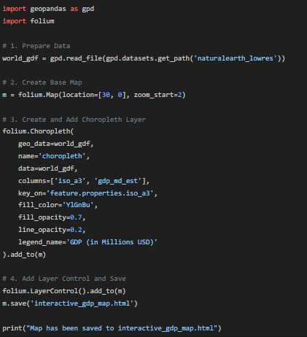
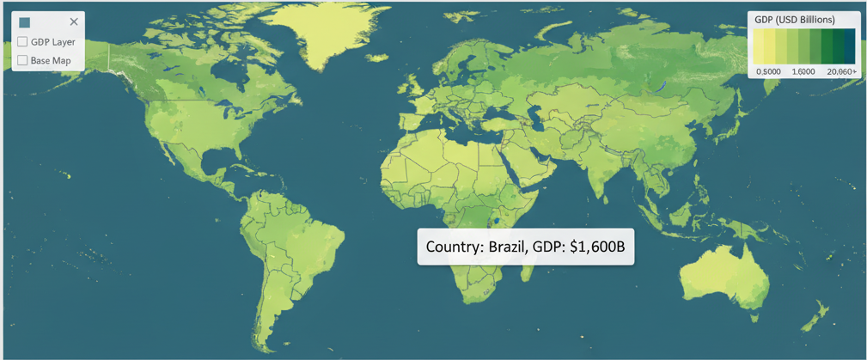
Creating an Interactive Choropleth with Folium
Annotations on the Screenshot (using arrows/callout boxes):
Point an arrow to the map legend in the top right, showing the GDP color scale.
Show the mouse cursor hovering over a country (e.g., Brazil).
Point an arrow to the layer control panel in the top right.
(Optional but effective) Show a tooltip that appears on hover, displaying the country name and its GDP. Note: Adding tooltips requires an extra folium.GeoJsonTooltip layer, which would be a great "advanced" addition to the code on the previous slide.
Summary Points:
The output is a single, self-contained HTML file.
Users can pan, zoom, and interact with the map.
The legend clearly communicates the meaning of the colors.
This visualization is ready to be embedded in a website or shared with colleagues.

Slide 51
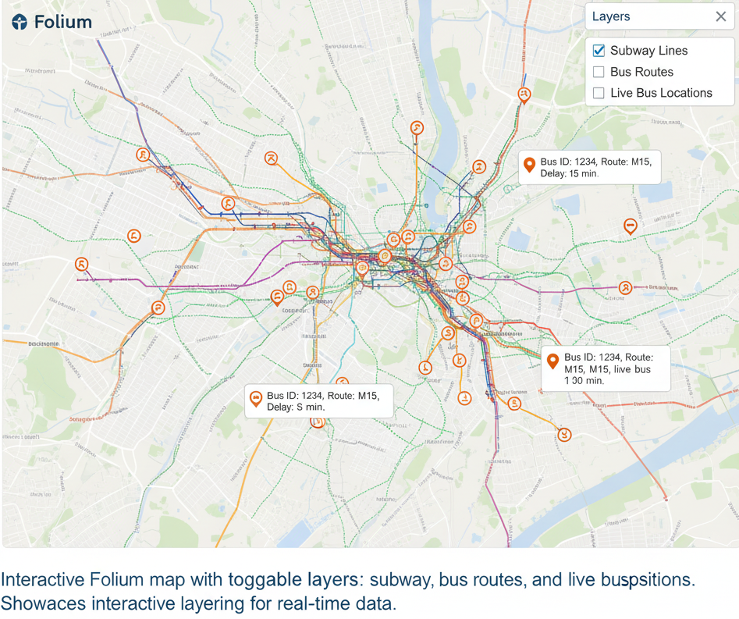
Application: Building a Real-Time Transit Map

Slide 52
Key Takeaways
Visualization is essential for exploration and communication in spatial analysis.
Always choose the right map type for your data (e.g., normalized choropleth, proportional symbol for counts, heatmap for density).
GIS tools are excellent for cartographic design and exploration.
Python provides a powerful, reproducible way to create both static and interactive maps that integrate directly with your machine learning workflow.

Slide 53

Myself
Dr. Giri Rajasekhar Gunnu
AI, Digital Twin & Industry Solutions Specialist | Industry 4.0 Specialist | Predictive Solutions Expert | Marine and Offshore Consultant
Professor of Practice, Andhra University
📧 g.giri.iitm@gmail.com
🔗 LinkedIn: girigunnu

Slide 54
Q&A
Welcome your questions and insights from all ranks
Your feedback helps us improve our CBPM implementation and ensures it meets the real-world needs of our fleet

